Slide 1
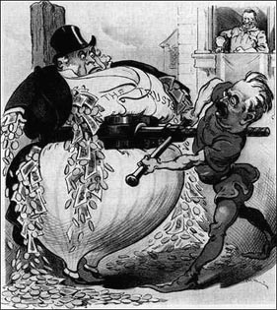
"Trust Buster" Depicted is T.R.'s response to the Colombians.T.R. smiles from the White House balcony as Cortelyou suqeezes the Trusts.

Slide 2
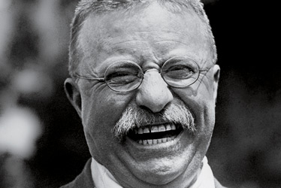

Slide 3
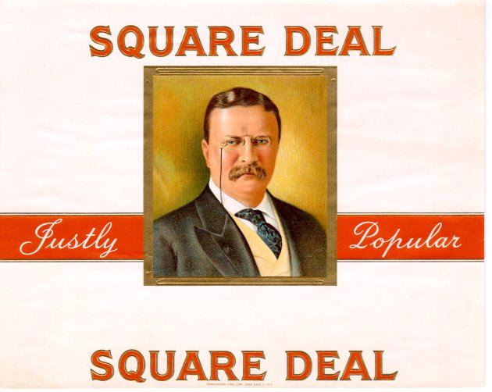

Slide 4
Panama Canal
The most spectacular of Roosevelt's foreign policy initiatives was the establishment of the Panama Canal.
For years, U.S. naval leaders had dreamed of building a passage between the Atlantic and Pacific oceans through Central America.

Slide 5
During the war with Spain, American ships in the Pacific had to steam around the tip of South America in two-month voyages to join the U.S. fleet off the coast of Cuba.
In 1901, the United States negotiated with Britain for the support of an American-controlled canal that would be constructed either in Nicaragua or through a strip of land -- Panama -- owned by Colombia.

Slide 6
In a flourish of closed-door maneuvers, the Senate approved a route through Panama, contingent upon Colombian approval.
When Colombia balked at the terms of the agreement, the United States supported a Panamanian revolution with money and a naval blockade, the latter of which prevented Colombian troops from landing in Panama.

Slide 7
In 1903, the Hay-Bunau-Varilla Treaty with Panama gave the United States perpetual control of the canal for a price of $10 million and an annual payment of $250,000.
When he visited Panama in 1906 to observe the building of the canal, Roosevelt became the first U.S. President to leave the country during his term of office

Slide 8
The process of building the canal generated advances in U.S. technology and engineering skills.
This project also converted the Panama Canal Zone into a major staging area for American military forces, making the United States the dominant military power in Central America.

Slide 9
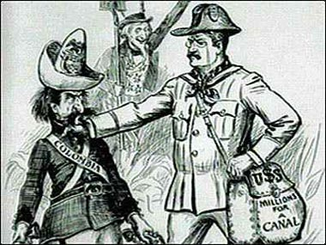
"Manhandling Colombia" Ater Colombia refused to accept T.R.'s offer to purchase the Panamanian Canal Zone, T.R. encouraged the indepedence movement in the rogue Colombian province of Panama. Later, Colombia accused the United States of stealing their territory without remuneration.

Slide 10
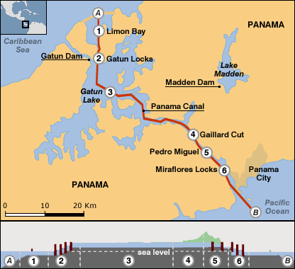

Slide 11
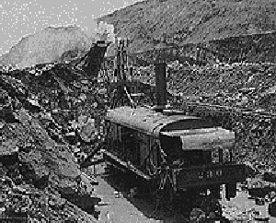

Slide 12
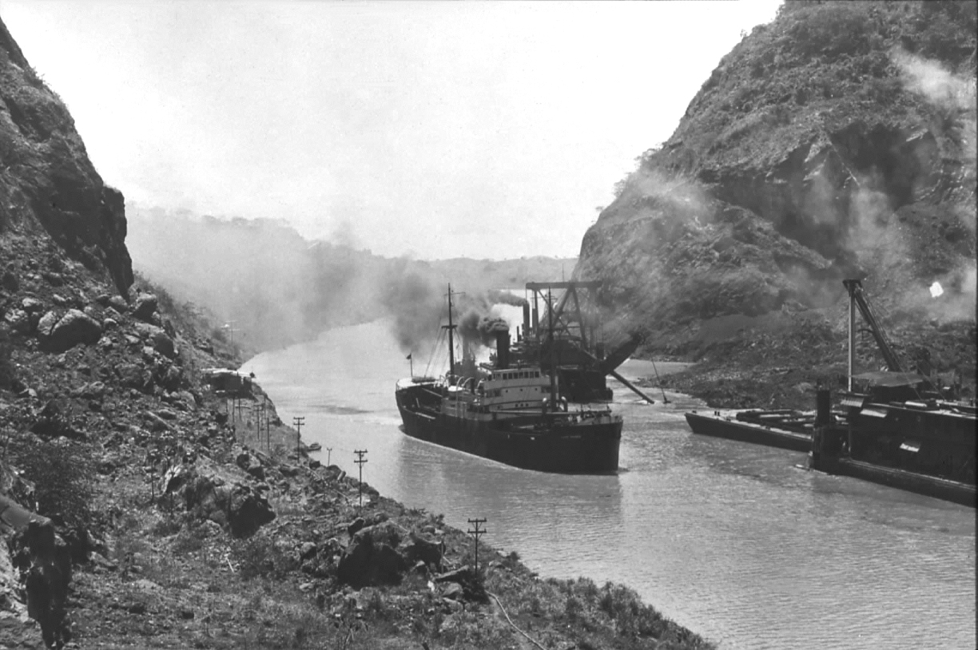

Slide 13
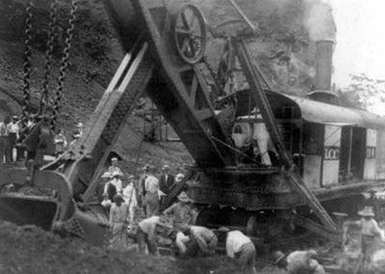

Slide 14
